Slide 1
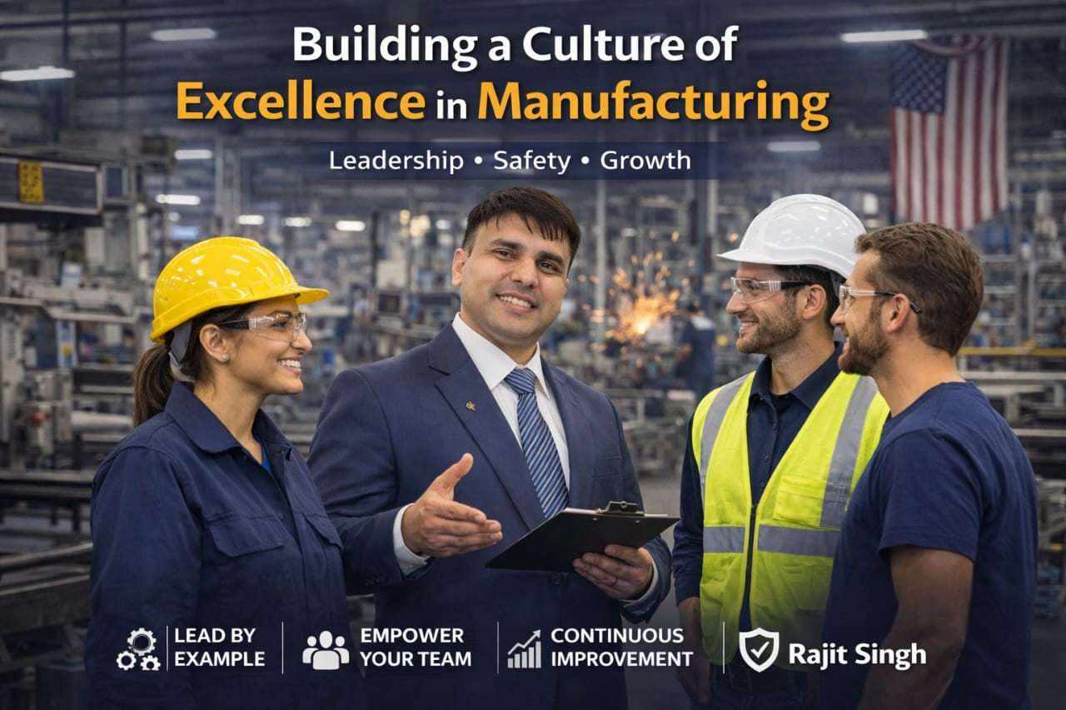
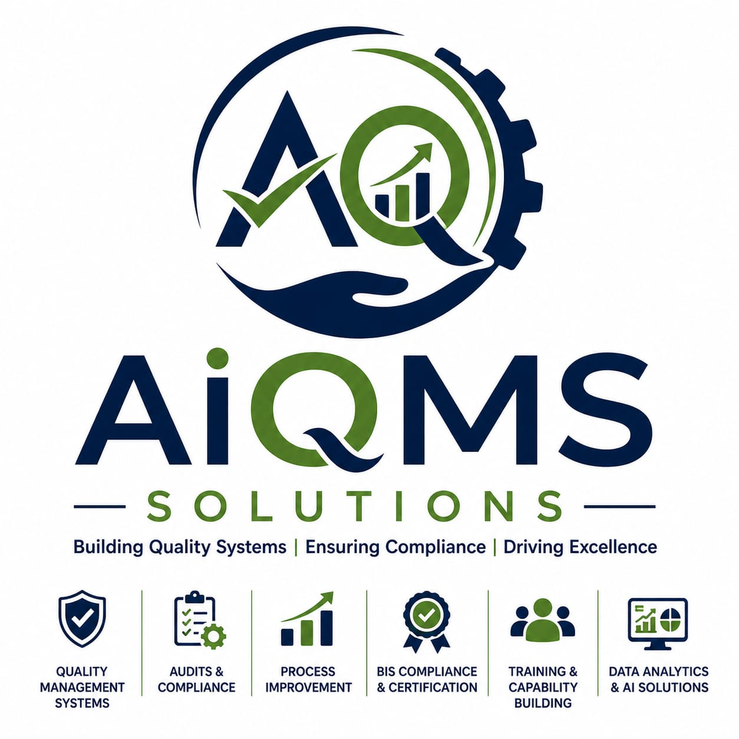
AiQMS
SOLUTIONS
COMPANY PROFILE
Building Quality Systems
Ensuring Compliance | Driving Excellence
20+
5+
100+
Years
Industries
Clients
Founded by: Sangeeta Yadav | Technical Expert: Rajit Singh
+91 99999432615 | www.aiqms.com | info@aiqms.com
20+ Years of Industrial Excellence

Slide 2
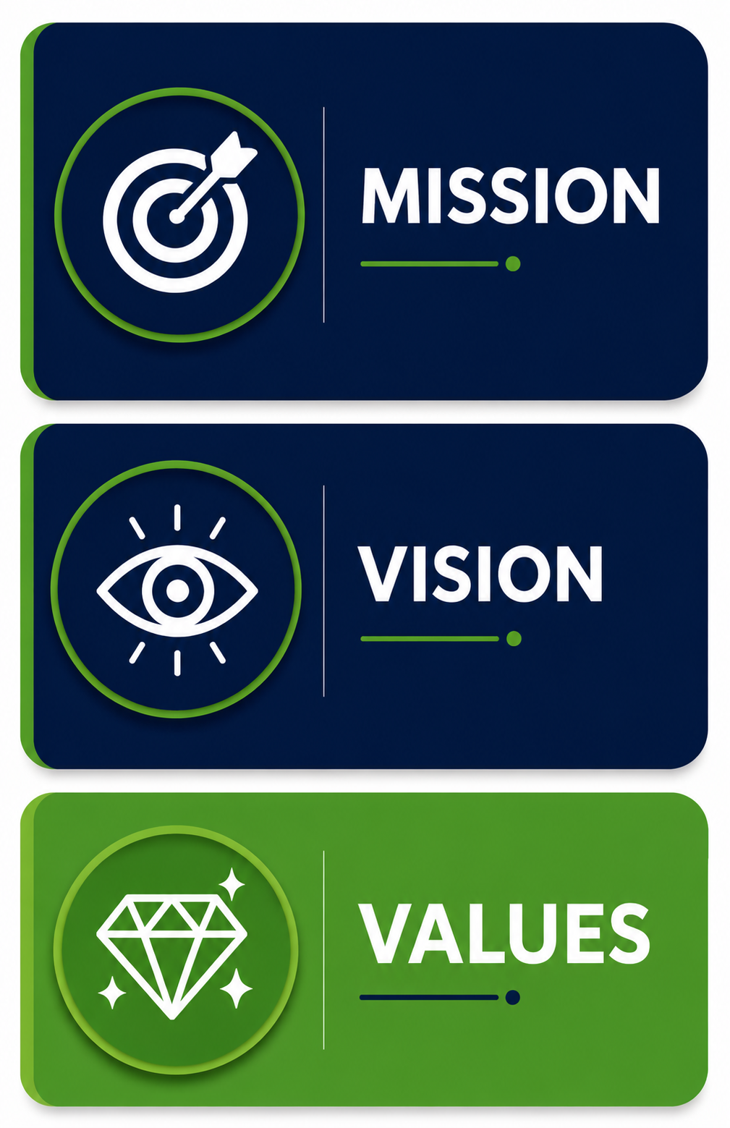
About AiQMS Solutions
AiQMS Solutions | www.aiqms.com
Your Trusted Quality Management Partner
Company Overview
AiQMS Solutions is a premier quality management consulting firm delivering end-to-end solutions across India's industrial landscape. With over 20 years of combined expertise, we help manufacturers achieve world-class standards in quality, compliance, and operational excellence.
Our multidisciplinary team brings hands-on experience from Automotive, Electrical, Electronics, Wire & Cable, and Home Appliance sectors — making us uniquely positioned to understand and solve real-world manufacturing challenges.
Mission: Deliver measurable quality via expert consulting & continuous improvement culture.
20+
5+
Years Experience
Industry Sectors
Vision: India's most trusted quality management partner enabling global competitiveness.
100+
50+
Values: Integrity • Excellence • Innovation • Customer Focus • Continuous Improvement
Projects Delivered
Corporate Clients

Slide 3
Our Journey
AiQMS Solutions | www.aiqms.com
From Concept to Industry Leader
MAY-2026
MAY-2026
MAY-2026
Foundation
Expansion
Excellence
AiQMS Solutions established with a vision to transform quality management in Indian manufacturing.
Expanded to Electronics & Wire Cable sectors. ISO 9001 & IATF 16949 consulting launched.
AI-enabled quality solutions introduced. Supplier development program launched.
MAY- 2026
Y- 2026
Y- 2026+
First Clients
Growth
Vision 2030
Secured first automotive and electrical sector clients. Built core consulting frameworks.
Crossed 50+ client milestone. Introduced Training & Metrology service lines.
Pan-India expansion, 500+ clients goal, international consulting aspirations.
Steadily growing | Deeply committed | Building India's Quality Future

Slide 4






Why AiQMS Solutions?
AiQMS Solutions | www.aiqms.com
Your Strategic Advantage in Quality Excellence
20+ Years Industry Experience
Technical Excellence
Customer-First Approach
Deep expertise across Automotive, Electrical, Electronics, Wire & Cable, and Home Appliance sectors with hands-on plant experience.
Advanced knowledge in ISO standards, IATF 16949, quality tools, metrology, and AI-enabled quality solutions.
Tailored solutions designed around your specific industry needs, plant challenges, and business objectives.
Proven Methodology
Rapid Results Delivery
Certified Expertise
Structured Assessment → Analysis → Planning → Implementation → Monitoring → Continuous Improvement framework.
Agile consulting approach delivering measurable improvements within 30-90 days of engagement.
Team of certified quality professionals with Lead Auditor, Six Sigma, and Lean Manufacturing credentials.

Slide 5






Industries We Serve
Delivering Quality Excellence Across Key Manufacturing Sectors
Automotive
Electrical
Electronics
IATF 16949, APQP, PPAP, MSA, SPC for Tier 1 & 2 manufacturers
ISO 9001, BIS compliance, quality systems for electrical equipment
PCB quality, ESD management, IPC standards, 7 QC tools training
Wire & Cable
Home Appliances
Manufacturing
Process quality, IS standards compliance, cable testing protocols
BIS certification, consumer product quality, safety compliance
Lean manufacturing, Kaizen, 5S, process optimization across sectors

Slide 6






Service Portfolio Overview
AiQMS Solutions | www.aiqms.com
Comprehensive Quality Solutions Under One Roof
Supplier
Development
AiQMS
Solutions
ISO
Consultancy
NPD
Support
Process
Optimization
Audit
Management
Quality
Improvement
Metrology
Training
Services

Slide 7
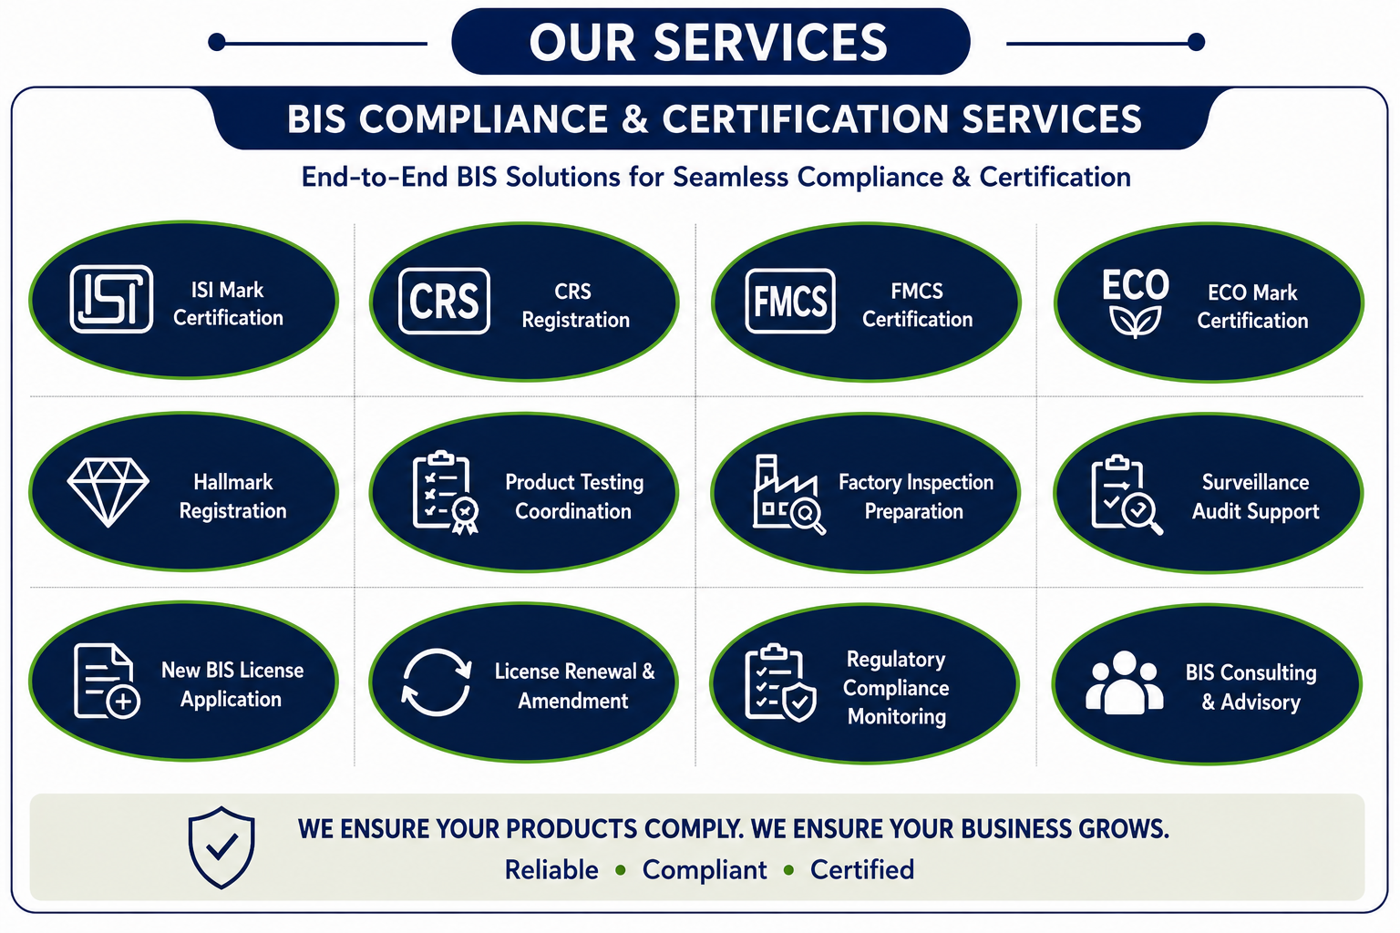
Service Portfolio Overview
AiQMS Solutions | www.aiqms.com
Comprehensive Quality Solutions Under One Roof
Supplier
Development
AiQMS
Solutions
NPD
Support
Audit
Management
Quality
Improvement
Training
Services

Slide 8
ISO Consultancy Services
AiQMS Solutions | www.aiqms.com
End-to-End Certification Support
ISO 9001:2015
IATF 16949
ISO 14001:2015
Quality Management
Automotive QMS
Environmental Management
Quality Management Systems — Gap analysis, documentation, implementation, and certification support.
Automotive-specific QMS for Tier 1 & 2 suppliers. APQP, PPAP, MSA, SPC integration.
Environmental management system design, implementation, and compliance support.
ISO 45001:2018
Documentation
Certification
Occupational Health & Safety
Technical Documentation
Certification Support
OH&S management systems for safer workplaces and regulatory compliance.
SOPs, Work Instructions, Quality Manuals, Control Plans, and complete document architecture.
Pre-audit assessments, certification body coordination, and post-audit CAPA management.

Slide 9
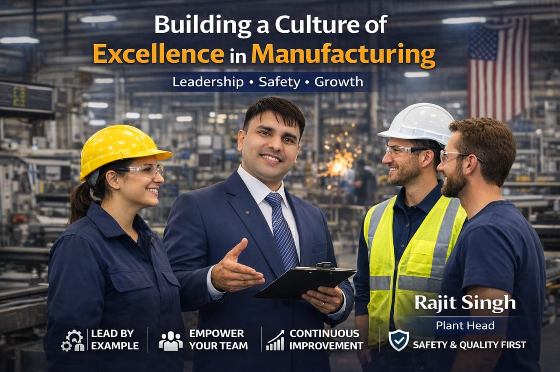


Quality Management Systems
AiQMS Solutions | www.aiqms.com
Building Robust Quality Foundations
SOP Development
Comprehensive Standard Operating Procedures that standardize processes and ensure consistency.
Process Mapping
Value stream mapping, process flow diagrams, SIPOC analysis for operational clarity.
Risk Management
FMEA, Risk Register, and proactive risk mitigation strategies across operations.
CAPA Management
Corrective & Preventive Action systems — Root Cause Analysis to effective closure.
Internal Audits
Scheduled audit programs, audit checklists, findings management, and closure tracking.

Slide 10


Process Optimization
AiQMS Solutions | www.aiqms.com
Driving Efficiency | Reducing Waste | Maximizing Value
Productivity Improvement
Cycle Time Reduction
OEE analysis, bottleneck elimination, and throughput optimization using proven industrial engineering methods.
Time & motion studies, process balancing, and work standardization to minimize non-value-added activities.
✓ Up to 35% improvement
✓ 20-40% cycle time savings
Cost Reduction
Lean Manufacturing
Waste identification using 7 wastes framework, cost of poor quality analysis, and savings validation.
5S, VSM, Kanban, Poka-Yoke, TPM implementation creating a sustainable lean enterprise culture.
✓ 15-25% cost reduction
✓ Sustainable systems
Kaizen Programs: Structured continuous improvement events, suggestion systems & cultural transformation

Slide 11
Metrology Services
Precision Measurement | Calibration Excellence | Reliable Data
Calibration Management
Measurement System Analysis
Instrument calibration planning, traceable calibration systems, and calibration recall management for complete measurement integrity.
Gauge R&R studies, Bias, Linearity, Stability analysis using AIAG MSA methodology ensuring reliable measurement data.
Gauge Control
Inspection Systems
Gauge inventory management, gauge design review, attribute and variable gauge systems, and control plan integration.
Incoming, In-process, and Final inspection system design, AQL sampling plans, and inspection protocol development.

Slide 12
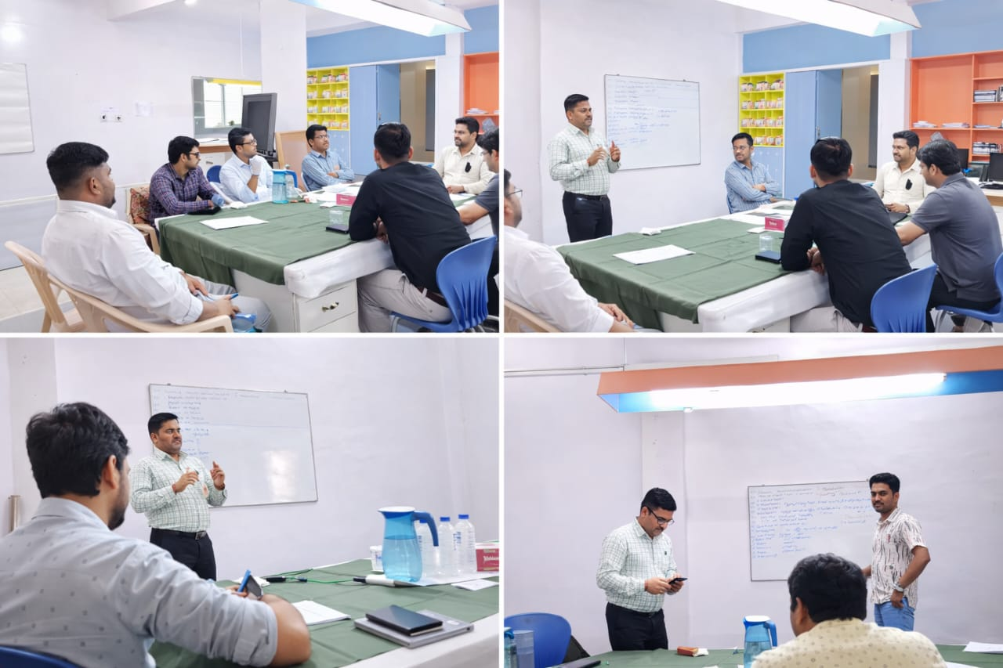
Training Services
AiQMS Solutions | www.aiqms.com
Building Competent Quality Professionals
Core Training Programs
7 QC Tools
Root Cause Analysis (8D)
FMEA (DFMEA & PFMEA)
Statistical Process Control (SPC)
Measurement System Analysis (MSA)
APQP (Advanced Product Quality Planning)
Real-World
Training
Delivered
PPAP (Production Part Approval)
Lean Manufacturing & Kaizen

Slide 13
New Product Development Support
AiQMS Solutions | www.aiqms.com
Quality from Design to Launch
PLAN
DESIGN
DEVELOP
VALIDATE
LAUNCH
APQP Support
Product Validation
Advanced Product Quality Planning — 5-phase structured process from planning through production approval with all deliverables.
DVP&R (Design Verification Plan & Report), performance and durability testing protocol development and execution oversight.
Process Validation
Design Review
IQ, OQ, PQ validation protocols for new equipment and processes ensuring consistent output from day one.
Structured design review gate management, DFMEA facilitation, and tolerance stack-up analysis support.

Slide 14

Supplier Quality Development
AiQMS Solutions | www.aiqms.com
Strengthening Your Supply Chain
Supplier Audits
Vendor Evaluation
Comprehensive supplier facility audits using Process & System audit checklists, capability assessment, and detailed findings report with corrective action requirements.
Structured vendor qualification and rating systems — technical capability assessment, quality system evaluation, and supplier approval process management.
Performance Monitoring
Supplier Development Training
PPM tracking, delivery performance metrics, quality scorecard development, and supplier performance review meetings facilitation.
On-site training programs at supplier locations covering quality tools, IATF requirements, and quality culture building for your vendor base.

Slide 15
Audit Management
AiQMS Solutions | www.aiqms.com
Systematic | Thorough | Actionable
Plan
Prepare
Execute
Report
Follow-up
Close
Internal Audits
Process Audits
ISO clause-wise internal audit programs, auditor training, schedule management, NCR tracking, and effectiveness verification.
Layer Process Audits (LPA), manufacturing process audit using turtle diagram approach and process checklist.
Product Audits
Compliance Audits
Finished product audit using customer standards, pre-dispatch quality gate audits, and escalation protocol management.
Regulatory compliance auditing for BIS, ISO, legal compliance, and customer-specific requirements assessment.

Slide 16
Our Methodology
AiQMS Solutions | www.aiqms.com
A Proven Framework for Sustainable Excellence
01
Assessment
02
Analysis
03
Planning
Current state analysis, gap identification, baseline metrics, and stakeholder interviews to understand the complete quality landscape.
Root cause analysis, data-driven insights, priority matrix development, and opportunity quantification for maximum impact.
Custom improvement roadmap, resource planning, KPI definition, implementation timeline, and risk mitigation strategy.
04
Implementation
05
Monitoring
06
Continuous Improvement
Phased execution, change management, team training, system deployment, and real-time progress monitoring.
KPI tracking, performance dashboards, management reviews, and course correction to ensure targets are achieved.
Kaizen culture embedding, knowledge transfer, and building internal capability for self-sustaining excellence.

Slide 17

Key Benefits to Clients
Measurable ROI | Lasting Transformation | Competitive Advantage
↓ 60%
↑ 35%
100%
↓ 25%
↑ 40%
Reduced Rejection
Improved Productivity
Better Compliance
Cost Reduction
Customer Satisfaction
Systematic quality improvement reduces customer returns, internal rejections, and warranty costs significantly.
Process optimization and waste elimination drive measurable productivity gains without capital investment.
ISO and regulatory compliance achieved with robust documentation and audit readiness at all times.
Reduced scrap, rework, warranty claims, and operational waste translates to direct bottom-line savings.
Improved delivery performance, quality consistency, and responsiveness strengthens client relationships.

Slide 18
Case Study 1
AiQMS Solutions | www.aiqms.com
Manufacturing Process Improvement — Automotive Component Supplier
BEFORE
AFTER — 90 Days
✗ PPM rejection: 5,200 PPM
✓ PPM rejection: 820 PPM (↓ 84%)
✗ First Pass Yield: 72%
✓ First Pass Yield: 94.5% (↑ 31%)
✗ Customer complaints: 12/month
✓ Customer complaints: 2/month (↓ 83%)
✗ Rework cost: ₹8.5 Lakhs/month
✓ Rework cost: ₹1.8 Lakhs/month (↓ 79%)
✗ No documented SOPs
✓ 28 SOPs documented & implemented
✗ No control plans in place
✓ Full control plan suite deployed

Slide 19
Case Study 2
AiQMS Solutions | www.aiqms.com
Quality System Implementation — Wire & Cable Manufacturer
Key Achievements
ISO 9001 Certification
Achieved in 4 months
PPM Reduction
3800 → 450 (88%↓)
Customer Satisfaction
62 → 91 CSAT score
Internal Audit Score
55% → 88%
OEE Improvement
68% → 84%
Cost Saving
₹22 Lakhs annually
Training Coverage
180 employees trained

Slide 20
Client Success Approach
AiQMS Solutions | www.aiqms.com
Partnership Model for Lasting Transformation
Understand
Design
Deep dive into client's specific challenges, industry requirements, and business objectives through structured discovery workshops.
Custom solution architecture tailored to the client's size, complexity, and goals. No one-size-fits-all approach.
CLIENT
SUCCESS
Execute
Sustain
Hands-on implementation with client team embedding, knowledge transfer, and real-time support throughout the journey.
Post-implementation monitoring, refresher training, and ongoing advisory to ensure results are maintained and improved.

Slide 21
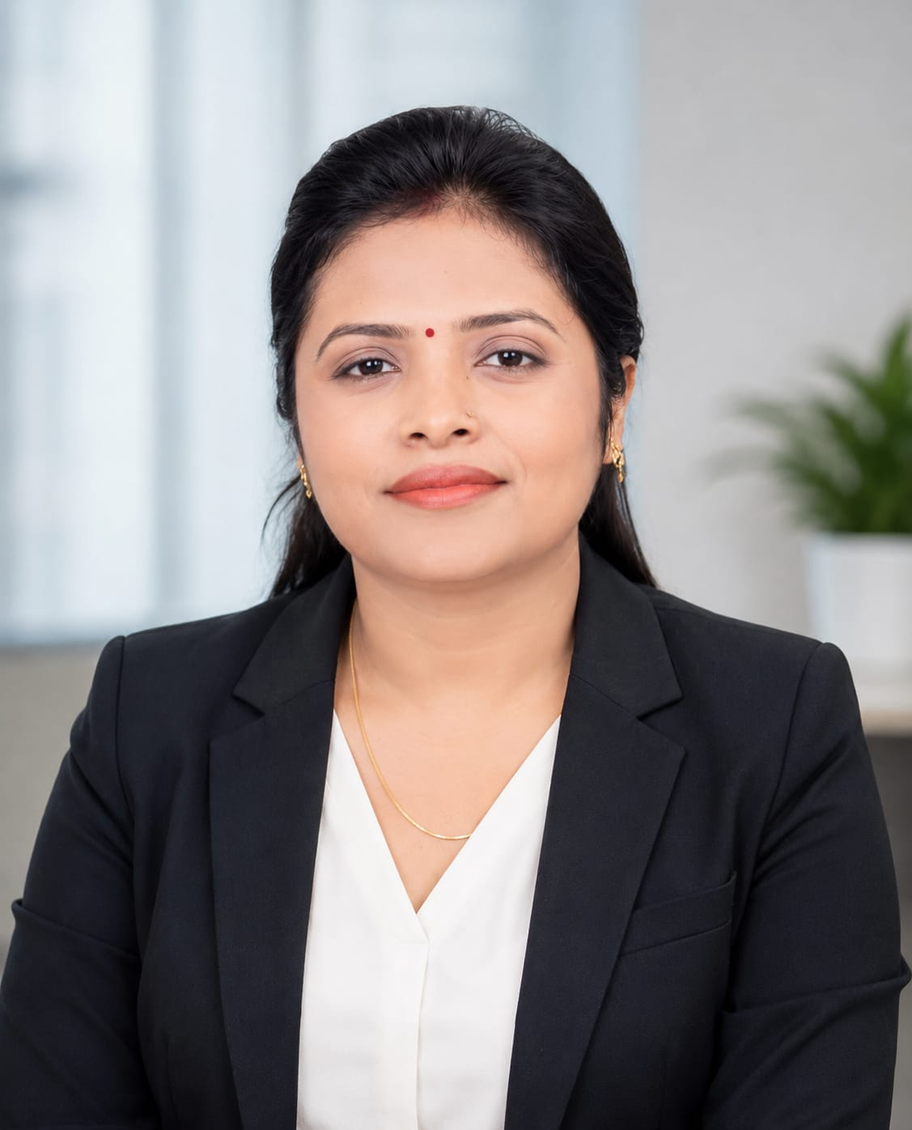

Management Team
AiQMS Solutions | www.aiqms.com
Experienced Professionals | Certified Experts
Sangeeta Yadav
Rajit Singh
Founder & CEO
( BSc, MSc & B.Ed. qualified with a strong academic foundation)
Technical Expert (Lean Six Sigma MBB |IATF 16149 | ISO 9001 Certified )
Highly Educated Professional
Visionary Entrepreneur
Education & Knowledge Development Expert
Professional Empowerment Advocate
AI & Industry Integration Leader
Growth & Opportunity Creator
• 20+ Years Manufacturing Experience
• Process Optimization & Lean Expert
• Metrology & Measurement Systems Specialist
• AI-Enabled Quality Solutions Pioneer
• ISO 9001 & IATF 16949 Lead Auditor
• Automotive, Electrical & Electronics Expert
• Quality Systems Architecture Specialist

Slide 22

Technology & Tools
AiQMS Solutions | www.aiqms.com
Modern Quality Management Powered by Intelligence
Quality Tools
Statistical Tools
7 QC Tools Suite
SPC Software
FMEA Software
Minitab Compatible
Control Charts
Gage R&R Studies
Pareto Analysis
Process Capability Analysis
Fishbone Diagrams
Regression Analysis
Audit Tools
AI-Enabled Quality
Digital Audit Checklists
Predictive Quality Analytics
NCR Management
Real-time Process Monitoring
CAPA Tracking System
AI Defect Classification
Layer Process Audit Tools
Smart Dashboard Reporting
Risk Register
Data-Driven Insights

Slide 23
Business Growth Roadmap
AiQMS Solutions | www.aiqms.com
Vision 2030 — Scaling Quality Excellence Across India
2025
2026–27
2028–30
Year 1 Goals
3-Year Plan
5-Year Vision
Expand to 50 active clients
100+ enterprise clients
Pan-India presence in 15 cities
Launch digital quality platform
Open regional offices: Delhi, Chennai, Pune
International consulting (UAE, SEA)
Hire 5 specialist consultants
Launch AiQMS Academy
500+ corporate clients
Enter Pune & Pune industrial belt
AI-powered audit tools rollout
AiQMS Certification Body (planned)
Launch online training programs
Revenue: ₹5 Crores target
Revenue: ₹20 Crores target

Slide 24
Company Registration & Compliance
AiQMS Solutions | www.aiqms.com
Fully Registered | Compliant | Trusted Partner
GST Registration
UDYAM Registration
GSTIN: XX-XXXXXXXXXXXXXX
UDYAM-XX-XX-XXXXXXX
AiQMS Solutions is a GST-registered entity, ensuring full tax compliance for all corporate transactions and invoicing.
Registered under MSME (Udyam Registration), enabling government scheme participation and priority sector access.
Business Compliance
Professional Indemnity
Ministry of Corporate Affairs
Insured Consulting Practice
Legally compliant business entity following all applicable Indian corporate laws and professional service regulations.
Professional indemnity coverage ensuring client protection and demonstrating our commitment to responsible consulting.
All registrations and compliance documents available upon request.

Slide 25

Why Partner With AiQMS Solutions?
The Choice That Transforms Your Quality Journey
01
20+ Years Experience
Proven expertise from real manufacturing environments — not just theoretical knowledge.
02
Industry Expertise
Deep domain knowledge in Automotive, Electrical, Electronics, Wire & Cable sectors.
03
Reliability & Trust
On-time delivery, transparent communication, and commitment to client success.
04
Industry Knowledge
Insider understanding of Indian manufacturing challenges, regulations, and opportunities.
05
Customized Solutions
No template approach — every engagement custom-designed for your specific situation.

Slide 26
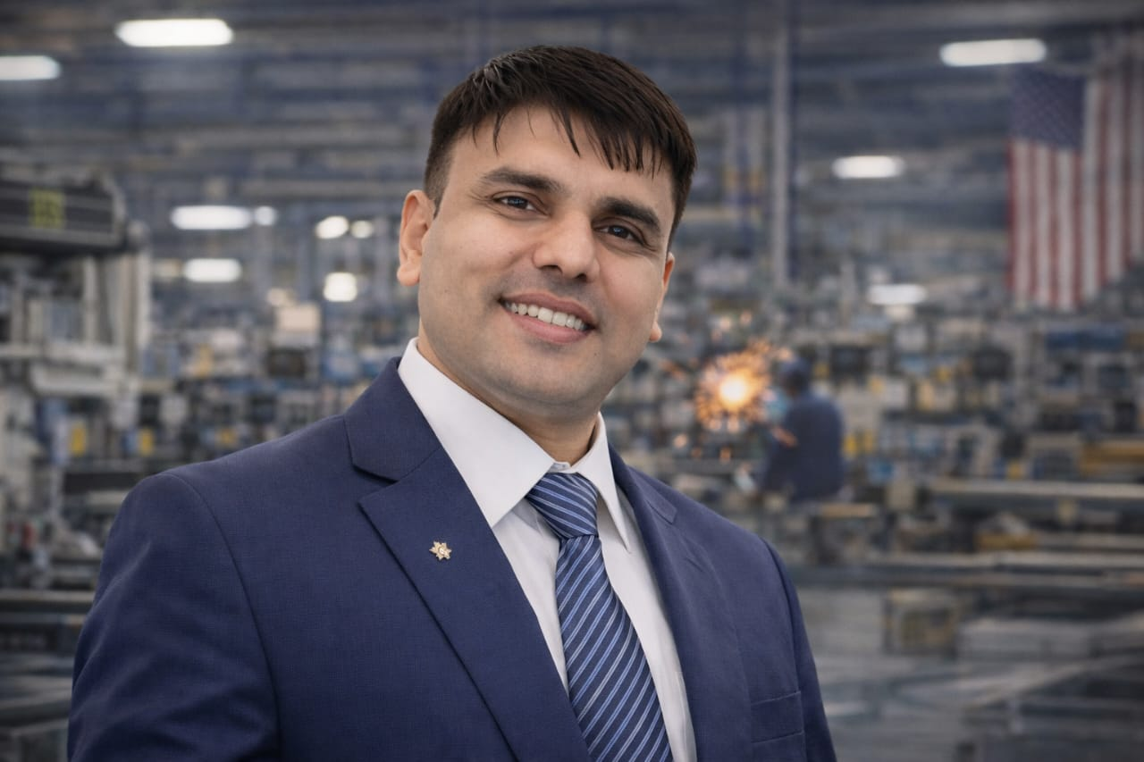




AiQMS SOLUTIONS
Building Quality Systems | Ensuring Compliance | Driving Excellence
+91 99994 32615
info@aiqms.com
www.aiqms.com
linkedin.com/company/aiqms-solutions
Thank You for Considering AiQMS Solutions as Your Quality Management Partner

Slide 27
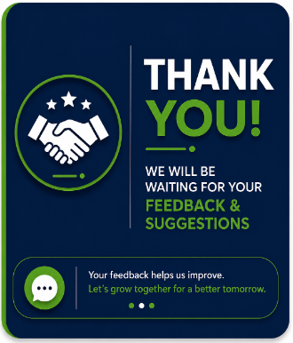
AiQMS SOLUTIONS
Building Quality Systems | Ensuring Compliance | Driving Excellence
Thank You for Considering AiQMS Solutions as Your Quality Management Partner

